Slide 1
Localizing your app
Developer's guide to Windows 10 Preview
Andy & Jerry

Slide 2
Localization
Multilingual toolkit

Slide 3

Locaization

Slide 4
Less than 50% of the world speaks English

Slide 5
Localization
Use XAML's <Element x:Uid />
The x:Uid does not need to be unique
Store localized values in Resources.resw
Store text strings in resources
Store settings in resources
Remember globalization

Slide 6
App language is automatic or programmatic

Slide 7
String resources
{ project }/Strings
Off the root, this is a convention
{ project }/Strings/en-US
Matching the local identifier
{ project }/Strings/en-US/Resources.resw
Resource file with localized strings

Slide 8
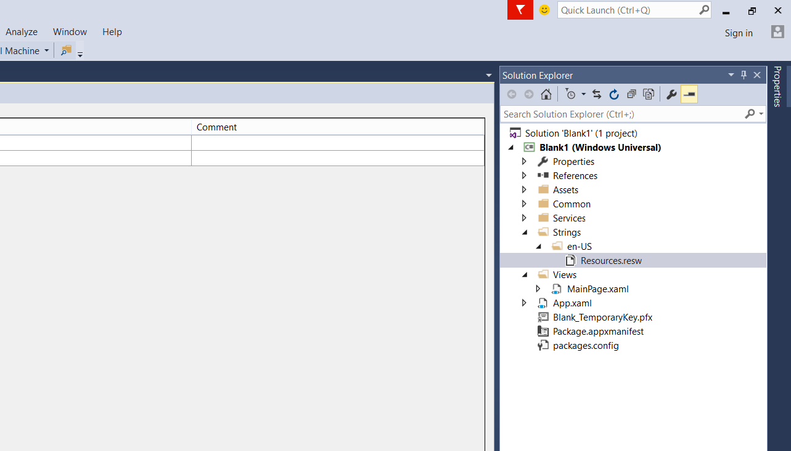

Slide 9
Localize
2:40

Slide 10
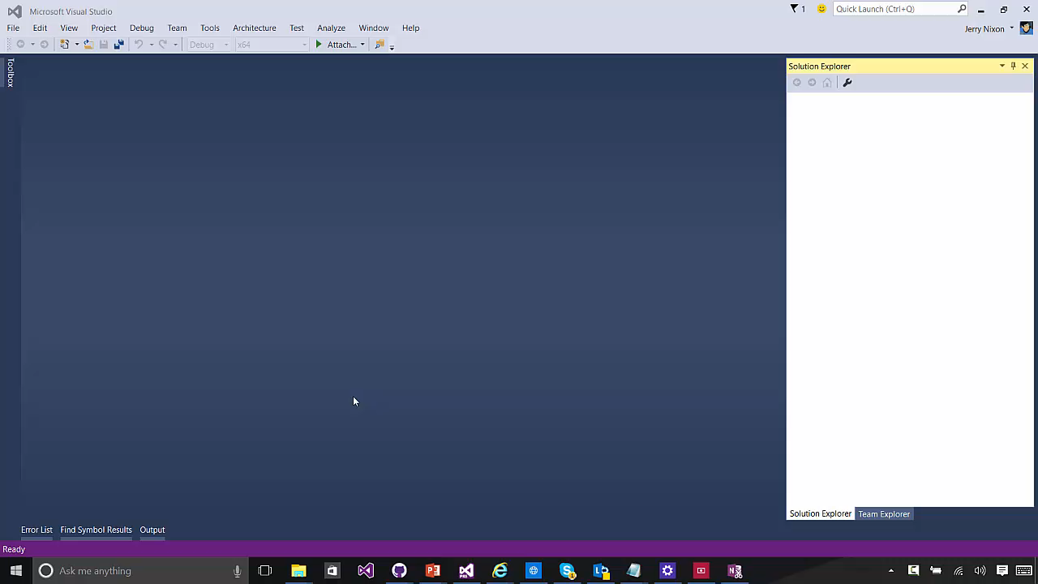

Slide 11
Resource loader
Access strings directly
Dialogs, errors, validate
async void Alert(string messageId)
{
var loader = Windows.ApplicationModel.Resources.ResourceLoader.GetForCurrentView();
var title = loader.GetString(string.Format("{0}.Title", messageId));
var message = loader.GetString(string.Format("{0}.Message", messageId));
var button = loader.GetString(string.Format("{0}.Button", messageId));
var dialog = new ContentDialog
{
Title = title,
Content = message,
PrimaryButtonText = button
};
await dialog.ShowAsync();
}

Slide 12

Multilingual toolkit

Slide 13
Microsoft unlocks other languages with the Multilingual Toolkit

Slide 14
Multilingual app toolkit
Support for XLF (version 1.2) files
Typical format for custom, translation houses
Inside Visual Studio
Microsoft translator service (machine learning)
Microsoft’s professionally translated strings (originally built for Office)
Outside Visual Studio
Free community tool

Slide 15
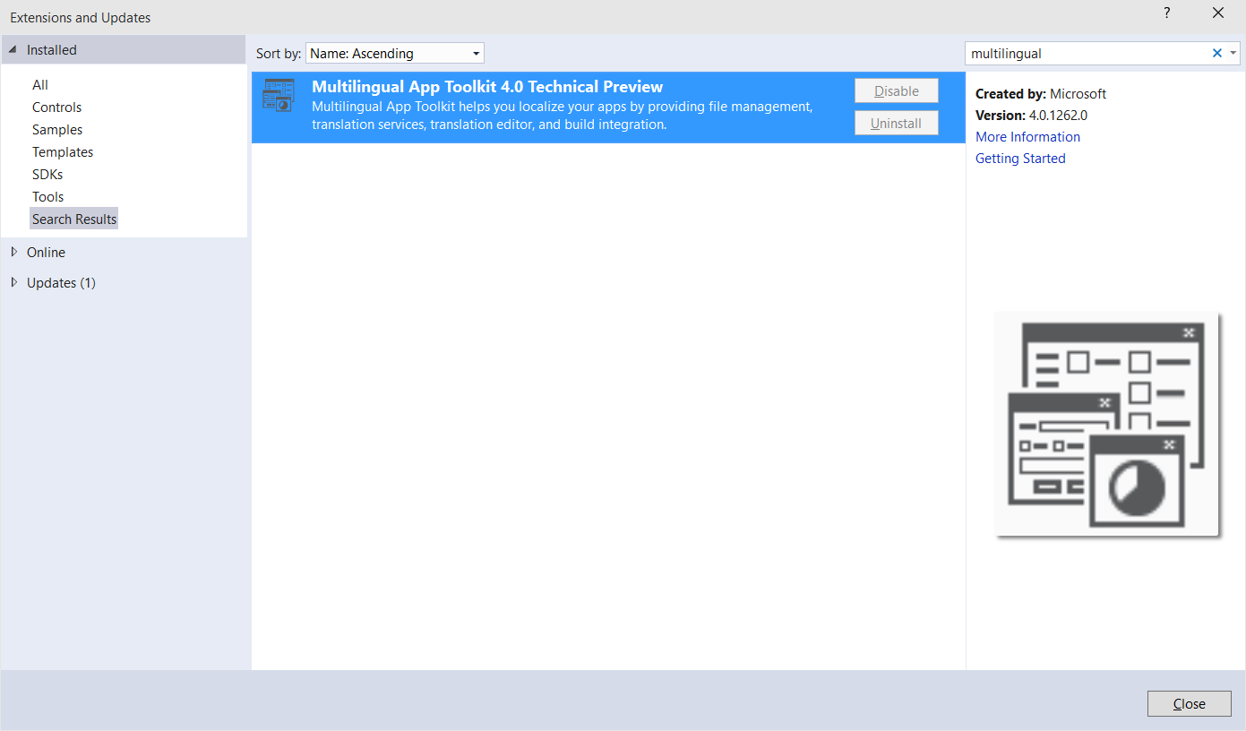
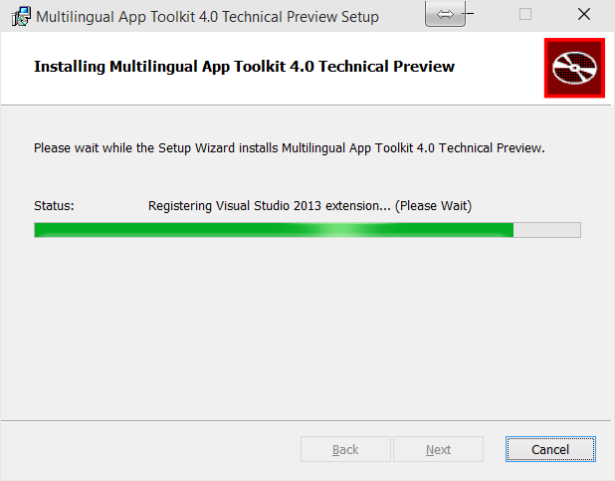

Slide 16
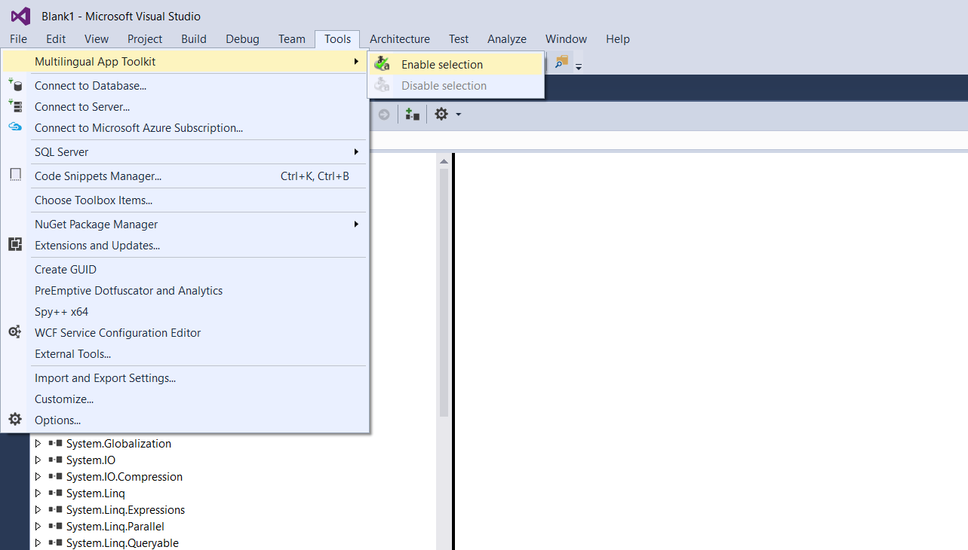

Slide 17
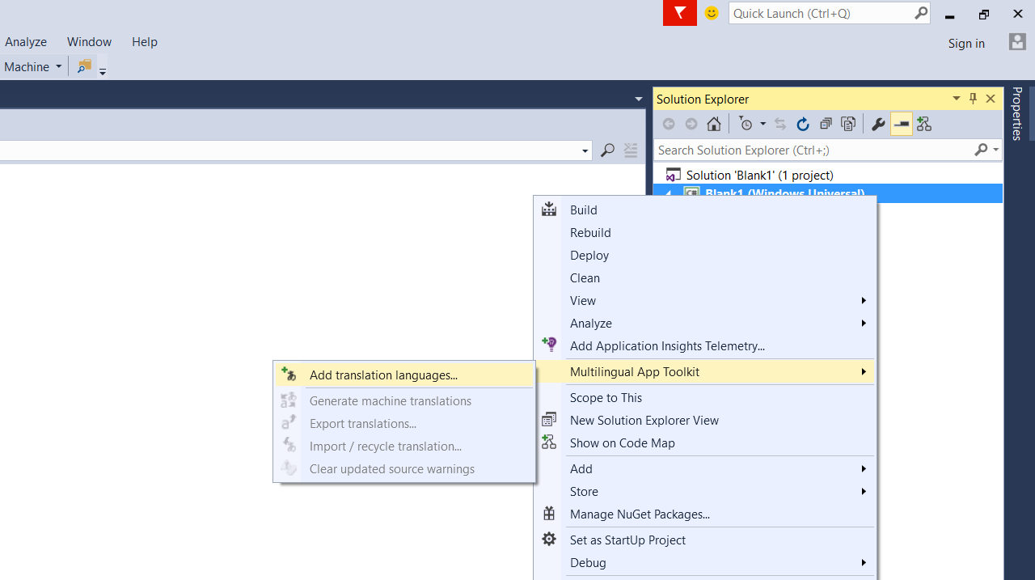

Slide 18
Your first language resource file acts as a template for the rest

Slide 19
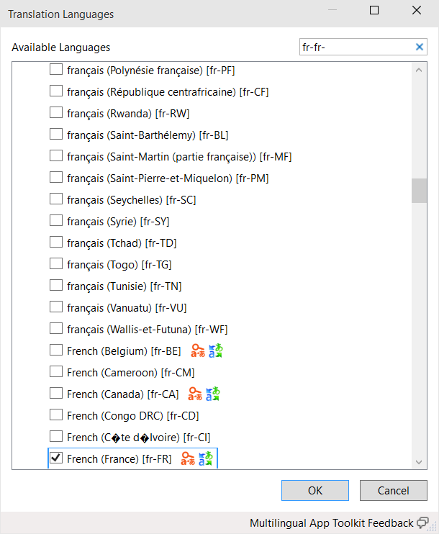

Slide 20
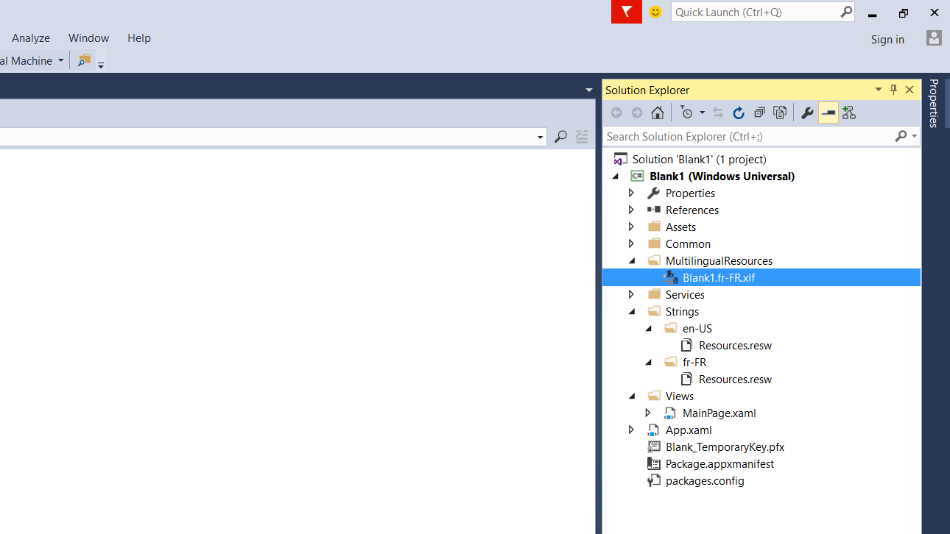

Slide 21
Using MAT

Slide 22
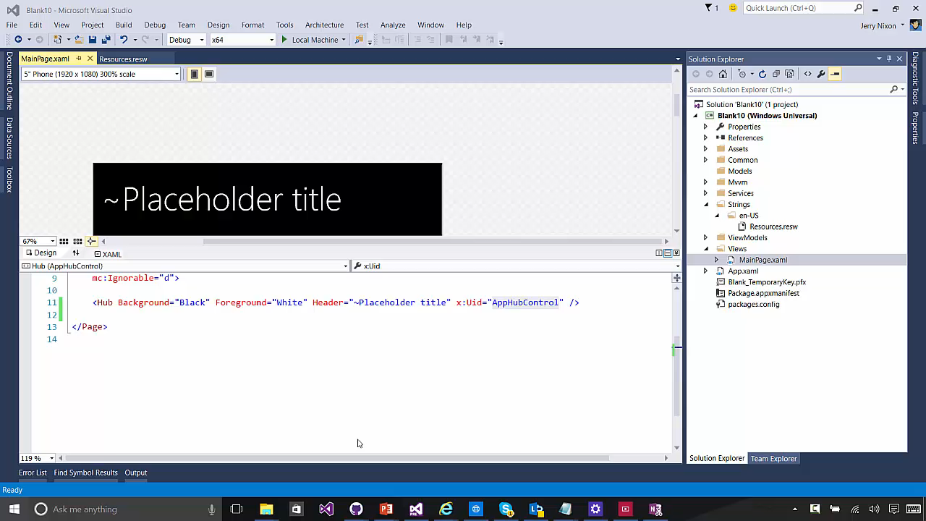

Slide 23
Remember to validate strings before you publish

Slide 24
Localization
Multilingual toolkit

